Slide 1
Numerical Methods I
Programming in Fortran (Chapter 3 & 4)
Instructor : Dr. Kishalay Mitra
Department Of Chemical Engineering
Indian Institute of Technology Hyderabad
kishalay@iith.ac.in
(https://sites.google.com/site/kishalaymitra/)

Slide 2
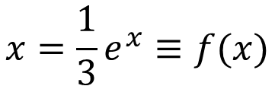
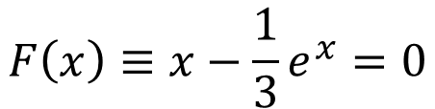
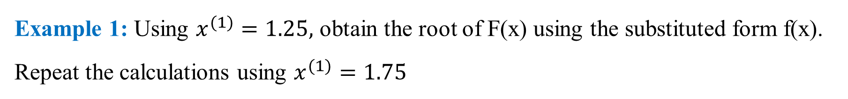
Single Variable Successive Substitution
Example 1: Using $x^{(1)}=1.25,$ obtain the root of F(x) using the substituted form f(x).
Repeat the calculations using $x^{(1)}=1.75$
$$F\left(x\right)≡x−\frac{1}{3}e^{x}=0$$
$$x=\frac{1}{3}e^{x}≡f(x)$$

Slide 3
program picard
implicit none
real :: x,f,tol = 0.00001
integer :: i
print *, "Enter initial guess for x: "
read *, x
do i = 1,1000
print *, "Iteration No. ", i
call my_fun(x,f)
print *, "X = ", x, "Function value = ", f
if (abs(x - f) .le. tol) exit
x = f
end do
print *, "The solution is x = ", x
end program picard
Step 1: Write a subprogram for the given function.
subroutine my_fun(x,f)
implicit none
real :: x,f
f = (1.0/3.0)*exp(x)
end subroutine my_fun
Step 2: Write a program for successive substitution method where the initial guess for x is taken from the user.
Initial guess for x = 1.25
The solution is x = 0.619077742

Slide 4
Initial guess for x = 1.75
Iteration No. 1
X = 1.75000000 Function value = 1.91820085
Iteration No. 2
X = 1.91820085 Function value = 2.26956606
Iteration No. 3
X = 2.26956606 Function value = 3.22506714
Iteration No. 4
X = 3.22506714 Function value = 8.38508797
Iteration No. 5
X = 8.38508797 Function value = 1460.41479
Iteration No. 6
X = 1460.41479 Function value = Infinity
Iteration No. 7
X = Infinity Function value = Infinity
A different choice of initial guess leads to divergence from the roots.

Slide 5
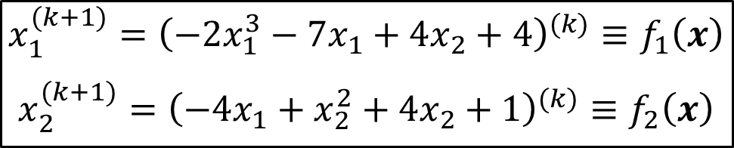
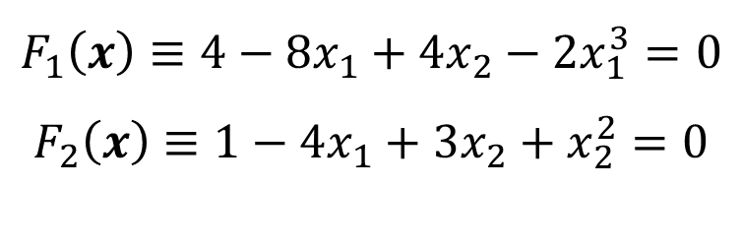
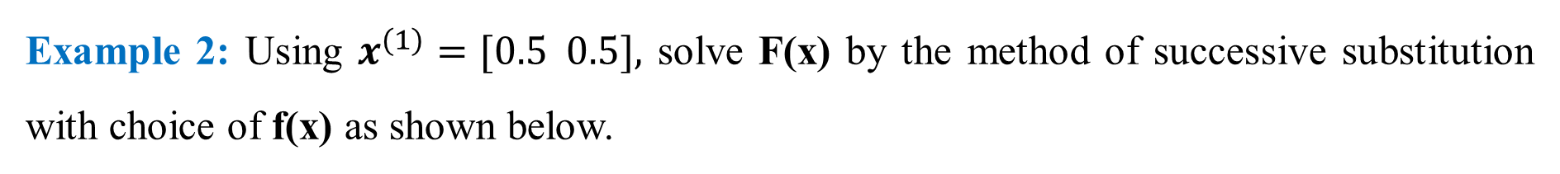
Multi-Variable Successive Substitution
Example 2: Using $x^{(1)}=[0.5 0.5],$ solve F(x) by the method of successive substitution with choice of f(x) as shown below.
$$F_{1}\left(x\right)≡4−8x_{1}+4x_{2}−2x_{1}^{3}=0$$
$$F_{2}\left(x\right)≡1−4x_{1}+3x_{2}+x_{2}^{2}=0$$
$$x_{1}^{(k+1)}={\left(−2x_{1}^{3}−7x_{1}+4x_{2}+4\right)}^{(k)}≡f_{1}\left(x\right)$$
$$x_{2}^{(k+1)}={\left(−4x_{1}+x_{2}^{2}+4x_{2}+1\right)}^{(k)}≡f_{2}\left(x\right)$$

Slide 6
Step 1: Write a subprogram for the given functions.
program multivar_ss
implicit none
real :: x1, x2, f1, f2, tol = 1e-06
integer :: i
print *, "Enter initial guess for x1: "
read *, x1
print *, "Enter initial guess for x2: "
read *, x2
do i = 1,1000
print *, "Iteration No. ", i
call my_fun(x1,x2,f1,f2)
write(*,*) x1, x2
print *, " "
if ((abs(x1 - f1) .le. tol) .and. (abs(x2 - f2) .le. tol)) exit
x1 = f1
x2 = f2
end do
print *, "The solution is x1 = ", x1, " x2 = ", x2
end program multivar_ss
subroutine my_fun(x1,x2,f1,f2)
implicit none
real :: x1,x2,f1,f2
f1 = -2*x1**3 - 7*x1 + 4*x2 + 4
f2 = -4*x1 + x2**2 + 4*x2 + 1
end subroutine my_fun
Step 2: Write a program for two-variable successive substitution method where the initial guess for x is taken from the user.

Slide 7
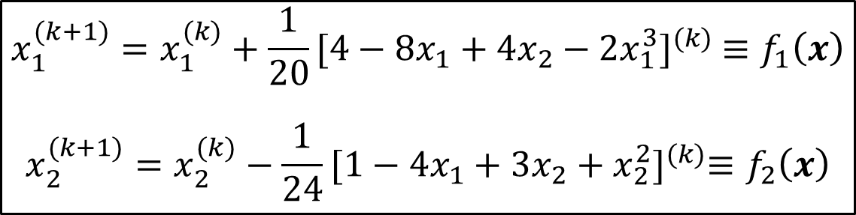
It is observed that the solution does not converge.
Iteration No. 1
0.5000 0.5000
Iteration No. 2
2.2500 1.2500
Iteration No. 3
-29.5312 -1.4375
Iteration No. 4
51713.0625 115.4414
Iteration No. 5
********************
Iteration No. 6
Infinity**********
Iteration No. 7
-Infinity -Infinity
Let us try a different choice of f(x):
$$x_{1}^{(k+1)}=x_{1}^{(k)}+\frac{1}{20}{[4−8x_{1}+4x_{2}−2x_{1}^{3}]}^{(k)} ≡f_{1}\left(x\right)$$
$$x_{2}^{(k+1)}=x_{2}^{(k)}−\frac{1}{24}{[1−4x_{1}+3x_{2}+x_{2}^{2}]}^{(k)}≡f_{2}\left(x\right)$$

Slide 8
subroutine my_fun2(x1,x2,f1,f2)
implicit none
real :: x1,x2,f1,f2
f1 = x1 + (1.0/20.0)*(4 - 8*x1 + 4*x2 - 2*x1**3)
f2 = x2 - (1.0/24.0) *(1 - 4*x1 + 3*x2 + x2**2)
end subroutine my_fun2
program multivar_ss
implicit none
real :: x1, x2, f1, f2, tol = 1e-06
integer :: i
print *, "Enter initial guess for x1: "
read *, x1
print *, "Enter initial guess for x2: "
read *, x2
do i = 1,1000
print *, "Iteration No. ", i
call my_fun2(x1,x2,f1,f2)
write(*,*) x1, x2
print *, " "
if ((abs(x1 - f1) .le. tol) .and. (abs(x2 - f2) .le. tol)) exit
x1 = f1
x2 = f2
end do
print *, "The solution is x1 = ", x1, " x2 = ", x2
end program multivar_ss
Initial guess for x = [0.5 0.5]
The solution is:
x1 = 0.6652 and x2 = 0.4776
“Convergence of solution thus depends on both choice of f(x) and initial estimate”.

Slide 9
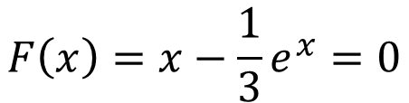

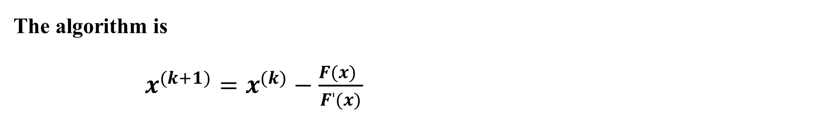
Single Variable Newton-Raphson Technique
Example 3: Using $x^{(1)}=1.25,$ solve F(x) using the Newton-Raphson technique -
$$F\left(x\right)=x−\frac{1}{3}e^{x}=0$$
The algorithm is
$x^{(k+1)}=x^{(k)}−\frac{F(x) }{Fˈ(x)}$
$${|F(x}^{(k+1)})−F\left(x^{\left(k\right)}\right)|<tolerance$$

Slide 10
real function functionValue(x)
implicit none
real, intent(in) :: x
functionValue = x - ((1.0/3.0) * exp(x))
end function functionValue
Step 1: Write a subprogram for the given function.
real function firstDerivative(x)
implicit none
real, intent(in) :: x
firstDerivative = 1 - ((1.0/3.0) * exp(x))
end function firstDerivative
Step 2: Write a subprogram for the derivative of the given function.

Slide 11
subroutine newtonRaphson
implicit none
real, external :: functionValue, firstDerivative
real :: x, xPrevious, slope, error, tolerance = 1.0e-6
integer :: iterNum = 0
print *, "Enter an initial guess for x:"
read *,x
write(*,*) "Iteration", "Root", "Error"
do while((error > tolerance) .or. (iterNum <= 1))
iterNum = iterNum + 1
slope = firstDerivative(x)
x = x - (functionValue(x) / slope)
error = abs(x - xPrevious)
write(*,*) iterNum, x, error
xPrevious = x
end do
write(*,*) "Root = ", x
end subroutine newtonRaphson
Step 3: Write a subprogram for the newton Raphson method by taking initial guess of 1.25 (tolerance = 1e-6)

Slide 12
program mainProgram
implicit none
call newtonRaphson
end program mainProgram
Step 4: Write a main program for calling the subprogram(s)
Enter an initial guess for x: 1.25
Iteration Root Error
1 1.7795 1.7795
2 1.5785 0.2011
3 1.5178 0.0607
4 1.5122 0.0056
5 1.5121 0.0000
6 1.5121 0.0000
Root = 1.51213455
Console Output -
Rapid Convergence as compared to successive substitutions technique (20 – SS, 6 – NR).

Slide 13
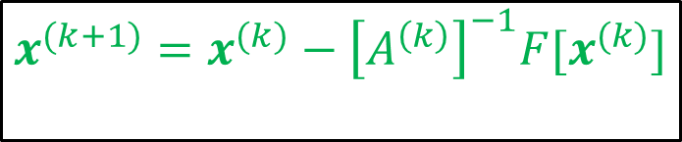
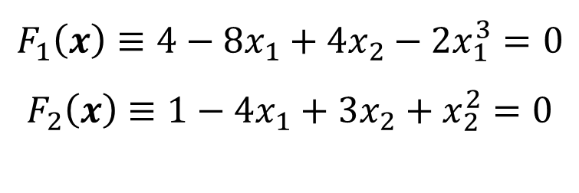
Multi-Variable Newton-Raphson
Example 4: Using $x^{(1)}=[0.5 0.5],$ solve F(x) using Newton-Raphson technique.
$$F_{1}\left(x\right)≡4−8x_{1}+4x_{2}−2x_{1}^{3}=0$$
$$F_{2}\left(x\right)≡1−4x_{1}+3x_{2}+x_{2}^{2}=0$$
$$x^{(k+1)}={x^{(k)}−{\left[A^{\left(k\right)}\right]}^{−1}F[x}^{(k)}]$$

Slide 14





Solution procedure
1) Write a subprogram for calculating given function values (in matrix format).
$${F [x}^{(k)}]$$
2) Write a subprogram for computing the Jacobian matrix.
$${[A}^{(k)}]$$
3) Write a subprogram for calculating the inverse of the Jacobian matrix.
$${{[A}^{(k)}] }^{−1}$$
4) Write a subprogram for multiplying the matrices obtained in step (1) and step (3).
$${{[A}^{(k)}] }^{−1}{F [x}^{(k)}]$$
5) Write a main program for two-variable Newton Raphson Technique where the initial guess for x is $[0.5 0.5]$ (tolerance = 1e-7).
$$x^{(k+1)}={{x^{k}−[A}^{(k)}] }^{−1}{F [x}^{(k)}]$$

Slide 15
Step 1: Write a subprogram for calculating given function values (in matrix format).
Step 2: Write a subprogram for computing the Jacobian matrix.
subroutine my_fun(x,f)
implicit none
real,dimension(2),intent(in) :: x
real,dimension(2),intent(out) :: f
f(1) = - 2 * x(1) ** 3 - 8 * x(1) + 4 * x(2) + 4
f(2) = - 4 * x(1) + x(2) ** 2 + 3 * x(2) + 1
end subroutine my_fun
subroutine my_jacobi(x,jacobi)
implicit none
real,dimension(2),intent(in) :: x
real,dimension(2,2),intent(out) :: jacobi
jacobi(1,1) = - 8 - 6 * x(1) ** 2
jacobi(1,2) = 4
jacobi(2,1) = - 4
jacobi(2,2) = 3 + 2 * x(2)
end subroutine my_jacobi

Slide 16
Step 3: Write a subprogram for calculating the inverse of the Jacobian matrix.
subroutine getInverse2D(a,aInverse)
implicit none
real,dimension(2,2),intent(in) :: a
real,dimension(2,2),intent(out) :: aInverse
real :: detA
aInverse(1,1) = a(2,2)
aInverse(1,2) = - a(1,2)
aInverse(2,1) = - a(2,1)
aInverse(2,2) = a(1,1)
detA =(a(1,1) * a(2,2)) - (a(1,2) * a(2,1))
aInverse = aInverse/detA
end subroutine getInverse2D
“This subprogram is specific to this problem. You may use your own generalized codes for calculating inverse of a matrix.”

Slide 17
subroutine matrixProd(a,b,c)
implicit none
real, dimension(2,2),intent(in) :: a
real, dimension(2,1), intent(in) :: b
real, dimension(2,1), intent(out) :: c
integer :: aRow, aColumn, i = 0, bColumn, cRow
real :: summation = 0
bColumn = 1
cRow = 1
do aRow = 1,2
do aColumn = 1,2
i = i + 1
c(cRow,bColumn) = summation + a(aRow,aColumn)*b(i,bColumn)
summation = c(cRow,bColumn)
end do
i = 0; summation = 0; cRow = cRow + 1
end do
end subroutine matrixProd
Step 4: Write a subprogram for multiplying the matrices obtained in step (1) and step (3).
You may write a code for multiplication of two matrices or use matmul keyword)

Slide 18
Step 5: Two-variable Newton-Raphson
do i = 1,1000
call my_fun(x,f)
call my_jacobi(x,jacobi)
call getInverse2D(jacobi, jacobInverse)
call matrixProd(jacobInverse, f, prodMat)
write(*, *) i,x(1),x(2),f(1),f(2)
x(1) = xPrevious(1) - prodMat(1)
x(2) = xPrevious(2) - prodMat(2)
if ((abs(x(1) - xPrevious(1)) .le. tol) .and. (abs(x(2) - xPrevious(2)) .le. tol)) exit
xPrevious = x
end do
print *, "The solution is x1 = ", x(1), " x2 = ", x(2)
end program NRM_multiVar
program NRM_multiVar
implicit none
real, dimension(2) :: x, xPrevious, prodMat,f
real, dimension(2,2) :: jacobi,jacobInverse
real :: tol = 1.0e-7
integer :: i
print *, "Enter initial guess for x1: "
read *, x(1)
print *, "Enter initial guess for x2: "
read *, x(2)
xPrevious(1) = x(1)
xPrevious(2) = x(2)
write(*,*)"Iteration“,"x(1)","x(2)","f(1)","f(2)”

Slide 19
Console Output
Enter initial guess for x1:
0.5
Enter initial guess for x2:
0.5
Iteration x(1) x(2) f(1) f(2)
1 0.50000 0.50000 1.75000 0.75000
2 0.68182 0.49432 -0.11119 0.00003
3 0.66541 0.47785 -0.00109 0.00027
4 0.66520 0.47758 -0.00000 0.00000
5 0.66520 0.47758 0.00000 -0.00000
6 0.66520 0.47758 -0.00000 0.00000
The solution is x1 = 0.665201068 x2 = 0.477575332
“Recall that one form of the method of SS from the same initial guess did not converge.”
“Rapid Convergence but at the cost of inverse of Jacobian.”

Slide 20
Syntax for opening and closing text file in Fortran
Open: The open command is used to open files.
Syntax: open(number, file = “name”)
Name of the file (with extension)
Positive integer used to refer the file (except 6 as Fortran uses that number to refer to the screen)
Ex: open (10, file = "scores.txt")
4 rows,
2 columns
To read: do i = 1, 4
read(10,*) x(i), y(i)
end do
Syntax: close(number)
Ex: close (10), close (3,8)
All files will automatically be closed when an end or stop statement is executed.
While handling large amounts of data – to avoid possible memory problems and to increase efficiency.

Slide 21
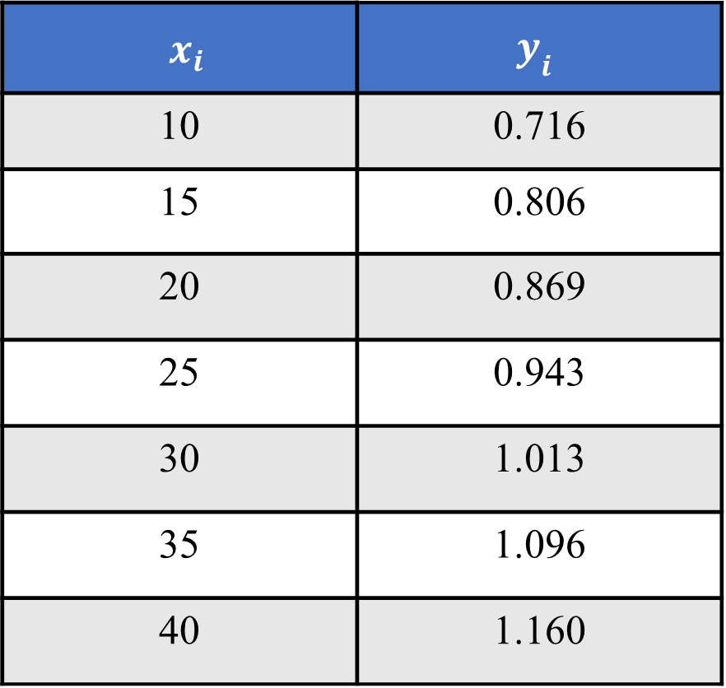
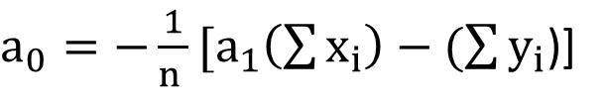
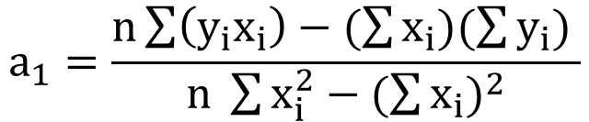

Least Squares Curve-Fit (Linear Regression)
Example: Given experimental data ($x_{i}$, $y_{i}$).
$x_{i}$ | $$y_{i}$$
10 | 0.716
15 | 0.806
20 | 0.869
25 | 0.943
30 | 1.013
35 | 1.096
40 | 1.160
Fit a straight line passing through these points.
$$y= a_{0}+a_{1}x$$
$$a_{1}=\frac{n\sum{\left(y_{i}x_{i}\right)−(\sum{x_{i})(\sum{y_{i}) }}}}{n \sum{x_{i}^{2}}−{(\sum{x_{i}})}^{2}}$$
$a_{0}=−\frac{1}{n }[a_{1}\left(\sum{x_{i}}\right)−(\sum{y_{i}}$)]

Slide 22
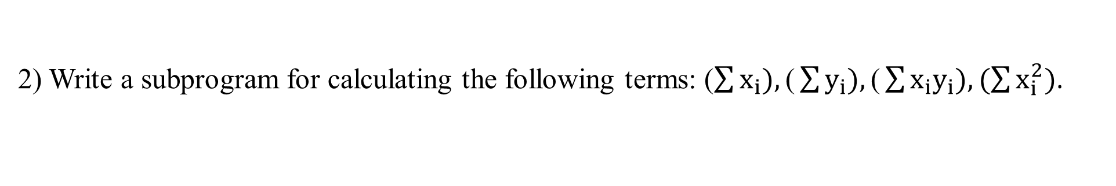

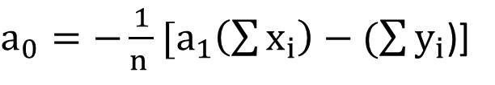
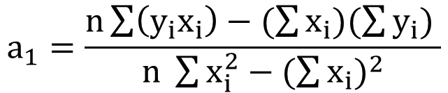
Solution procedure
1) Using the given values for ($x_{i}$, $y_{i}$), create a text file “data.txt” (in matrix format with space between the two rows).
Save it in the current Fortran project folder.
2) Write a subprogram for calculating the following terms: ($\sum{x_{i}}),\text{(}\sum{y_{i}}),\text{(}\sum{x_{i}y_{i}}),(\sum{x_{i}^{2})}$.
Inputs: x, y, n (dimension of x and y) Outputs: Calculated terms
3) Write a main program to calculate $a_{1}$ (slope) and $a_{0}$ (y-intercept) of the line using the following equations: (use the data from the created text file in step 1)
$$a_{1}=\frac{n\sum{\left(y_{i}x_{i}\right)−(\sum{x_{i})(\sum{y_{i}) }}}}{n \sum{x_{i}^{2}}−{(\sum{x_{i}})}^{2}}$$
$a_{0}=−\frac{1}{n }[a_{1}\left(\sum{x_{i}}\right)−(\sum{y_{i}}$)]
Print the output in this form:
$$y= a_{0}+a_{1}x$$

Slide 23
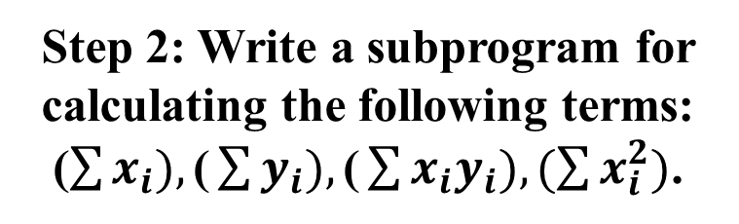
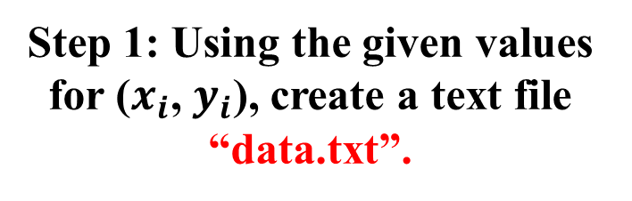
subroutine lsq(x,y,n,sumX,sumXX,sumY,sumXY)
implicit none
integer, intent(in) :: n
real, dimension(n),intent(in) :: x,y
real, intent(out) :: sumX, sumXX, sumY, sumXY
integer :: j
sumX = 0; sumY = 0; sumXX = 0; sumXY = 0
do j = 1, n
sumX = sumX + x(j)
sumY = sumY + y(j)
sumXX = sumXX + (x(j))**2
sumXY = sumXY + ((x(j)) * (y(j)))
end do
end subroutine lsq
Step 1: Using the given values for ($x_{i}$, $y_{i}$), create a text file “data.txt”.
10 0.716
15 0.806
20 0.869
25 0.943
30 1.013
35 1.096
40 1.160
Step 2: Write a subprogram for calculating the following terms: ($\sum{x_{i}}),\text{(}\sum{y_{i}}),\text{(}\sum{x_{i}y_{i}}),(\sum{x_{i}^{2})}$.

Slide 24
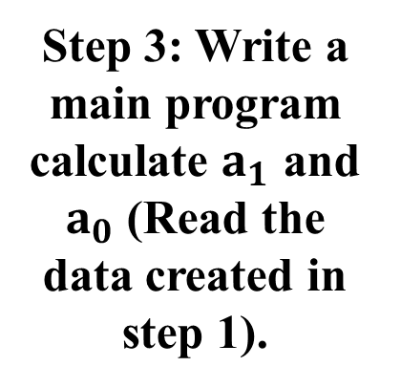
program main
implicit none
integer :: i, n = 7
real,dimension(7) :: x , y
real :: sumX, sumXX, sumY, sumXY, slope, yIntercept
open(2, file = "data.txt")
do i = 1, n
read(2,*) x(i), y(i)
end do
close(2)
call lsq(x,y,n,sumX,sumXX,sumY,sumXY)
slope = ((n * sumXY) - (sumX * sumY)) / ((n * sumXX) - (sumX)**2)
yIntercept = - ((slope * sumX) - sumY)/n
print*,"The best fit straight line is y = ",yintercept, "+", slope, "x"
end program main
Step 3: Write a main program calculate $a_{1}$ and $a_{0}$ (Read the data created in step 1).
Console Output
The best fit straight line is y = 0.57614 + 0.014686 x

Slide 25
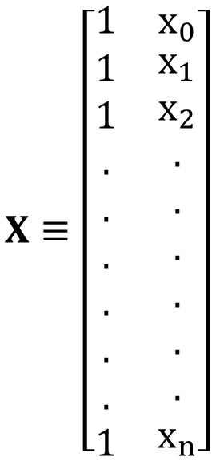
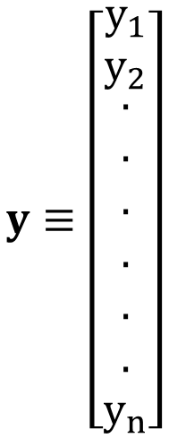
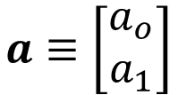
In matrix format, $Aa≡\left(X^{T}X\right)a=X^{T}y≡b$
where,
$$X≡\left[\begin{matrix}1 & x_{0} \\ \begin{aligned}1 \\ 1 \\ . \\ . \\ . \\ . \\ . \\ . \\ 1\end{aligned} & \begin{aligned}x_{1} \\ x_{2} \\ . \\ . \\ . \\ . \\ . \\ . \\ x_{n}\end{aligned}\end{matrix}\right]$$
$$y≡\left[\begin{matrix}y_{1} \\ y_{2} \\ \begin{aligned}. \\ . \\ . \\ . \\ . \\ . \\ y_{n}\end{aligned}\end{matrix}\right]$$
$$a≡\left[\begin{matrix}a_{o} \\ a_{1}\end{matrix}\right]$$
The above equation is in the form of Ax = b.
Techniques such as Gauss-elimination, Gauss Jordan, etc. can be used to solve it.

Slide 26


program main
implicit none
integer :: n = 7, i
real,dimension(7,2) :: x
real,dimension(2,7) :: xTrans
real,dimension(2,2) :: p
real,dimension(7,1) :: y
real,dimension(2,1) :: a, q
real,dimension(2,3) :: augA
x(:,1) = 1
open(2, file = "data.txt")
do i = 1, n
read(2,*) x(i,2), y(i,1)
end do
close(2)
xTrans = Transpose(x)
$$\left(X^{T}X\right)a=X^{T}y$$
$$\left(p\right)a=q$$
p = matmul(xTrans, x)
q = matmul(xTrans, y)
augA(1:2,1:2) = p(1:2,1:2)
augA(1,3) = q(1,1)
augA(2,3) = q(2,1)
call gaussEliminationMethod(augA,2,a)
print*,"The best fit straight line is y = ",a(1,1), "+", a(2,1), "x"
end program main

Slide 27
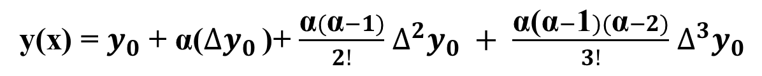
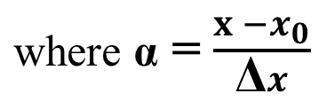
Newton’s Interpolation (Forward Difference)
Example: Fit a 3rd degree polynomial passing through the 4 data points shown below and calculate y at x = 1.5, 2.5 and 3.5.
i | x_{i} | y_{i}
0 | 1 | 7
1 | 2 | 17
2 | 3 | 53
3 | 4 | 157
y(x) = $y_{0}$ + α($∆y_{0}$ )+ $\frac{\text{α}(\text{α}−1)}{2!}$ ${∆^{2}y}_{0} + \frac{\text{α}\text{(}\text{α}−\text{1})(\text{α}−2)}{3!}$ ${∆^{3}y}_{0}$
$\text{where} \text{α}$ = $\frac{x −x_{0}}{\text{Δ}x}$

Slide 28
Newton’s Interpolation (Forward Difference)
i | x_{i} | y_{i} | Δy_{i} | Δ²y_{i} | Δ³y_{i}
0 | 1 | 7
1 | 2 | 17
2 | 3 | 53
3 | 4 | 157
10
26
36
42
68
104

Slide 29
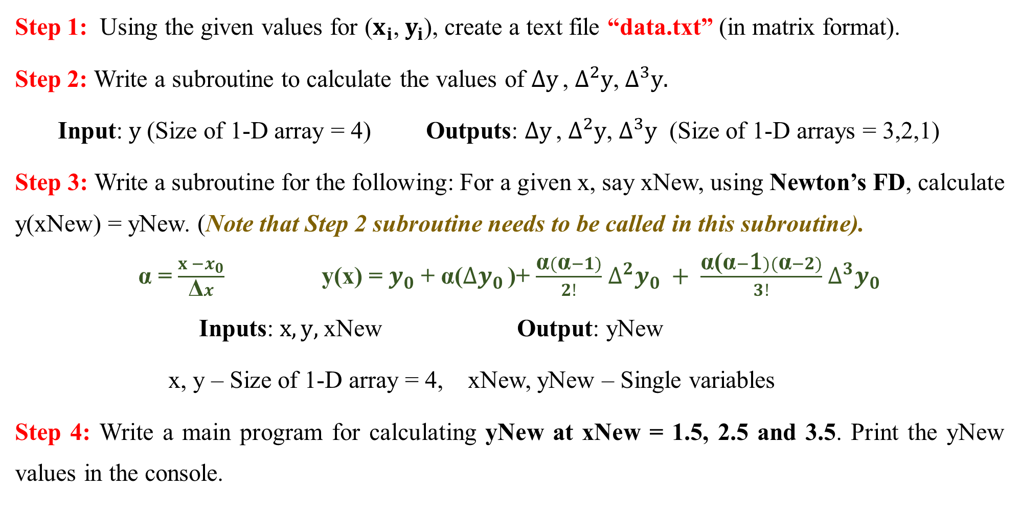
Solution Procedure
Step 1: Using the given values for ($x_{i}$, $y_{i}$), create a text file “data.txt” (in matrix format).
Step 2: Write a subroutine to calculate the values of $∆y$ , $∆^{2}y$,${ ∆}^{3}y.$
Input: $y$(Size of 1-D array = 4) Outputs: $∆y$ , $∆^{2}y$, $∆^{3}y$ (Size of 1-D arrays = 3,2,1)
Step 3: Write a subroutine for the following: For a given x, say xNew, using Newton’s FD, calculate y(xNew) = yNew. (Note that Step 2 subroutine needs to be called in this subroutine).
$\text{α}$ = $\frac{x −x_{0}}{\text{Δ}x}$ y(x) = $y_{0}$ + α($∆y_{0}$ )+ $\frac{\text{α}(\text{α}−1)}{2!}$ ${∆^{2}y}_{0} + \frac{\text{α}\text{(}\text{α}−\text{1})(\text{α}−2)}{3!}$ ${∆^{3}y}_{0}$
Inputs: $x,y,$xNew Output: yNew
x, y – Size of 1-D array = 4, xNew, yNew – Single variables
Step 4: Write a main program for calculating yNew at xNew = 1.5, 2.5 and 3.5. Print the yNew values in the console.

Slide 30
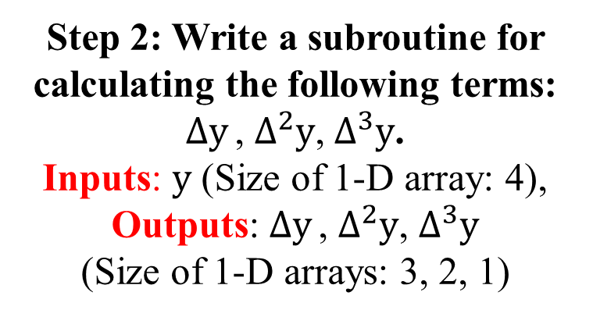

Step 1: Using the given values for ($x_{i}$, $y_{i}$), create a text file “data.txt”.
subroutine differences(y, delY, del2Y, del3Y)
implicit none
real, dimension(4),intent(in) :: y
real, dimension(3), intent(out) :: delY
real, dimension(2), intent(out) :: del2Y
real, intent(out) :: del3Y
integer :: i
do i = 1,3
delY(i) = y(i+1) - y(i)
end do
do i = 1,2
del2Y(i) = delY(i+1) - delY(i)
end do
del3Y = del2Y(2) - del2Y(1)
end subroutine differences
1 7
2 17
3 53
4 157
Step 2: Write a subroutine for calculating the following terms: $∆y$ , $∆^{2}y$,${ ∆}^{3}y$.
Inputs: $y$ (Size of 1-D array: 4),
Outputs: $∆y$ , $∆^{2}y$, $∆^{3}y$
(Size of 1-D arrays: 3, 2, 1)

Slide 31
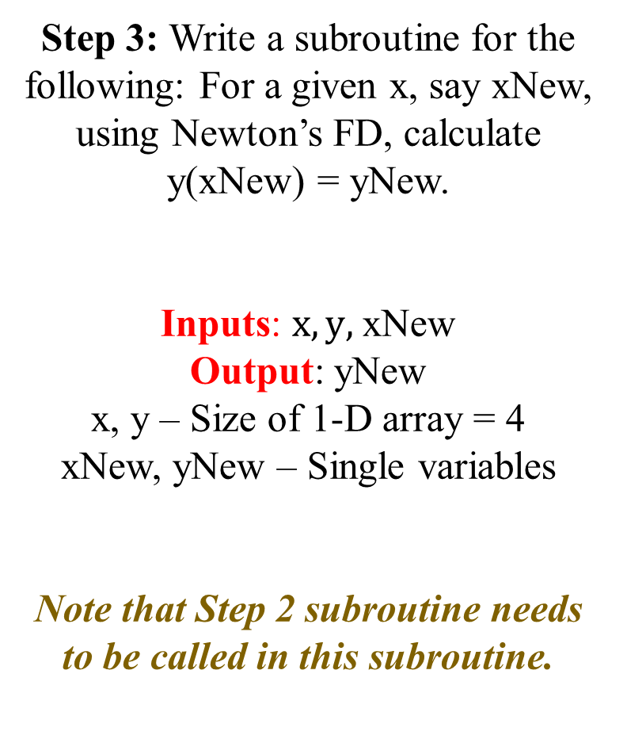
subroutine getvalues(x, y, xNew, yNew)
implicit none
real, dimension(4), intent(in) :: x, y
real, intent(in) :: xNew
real, intent(out) :: yNew
real, dimension(3) :: delY
real, dimension(2) :: del2Y
real :: del3Y, a
call differences(y,delY,del2Y,del3Y)
a = (xNew - x(1))/(x(2) - x(1))
yNew = y(1) + delY(1)*a + del2Y(1)*(a**2 - a)/2 + del3Y*((a**2 - a)*(a - 2))/6
end subroutine getvalues
Step 3: Write a subroutine for the following: For a given x, say xNew, using Newton’s FD, calculate y(xNew) = yNew.
Inputs: $x,y,$xNew
Output: yNew
x, y – Size of 1-D array = 4
xNew, yNew – Single variables
Note that Step 2 subroutine needs to be called in this subroutine.

Slide 32
program main
implicit none
real, dimension(4) :: x,y
real, dimension(3) :: xNew, yNew
integer :: i
open(10,file = "data.txt")
do i = 1,4
read(10,*) x(i), y(i)
end do
close(10)
xNew(1) = 1.5
xNew(2) = 2.5
xNew(3) = 3.5
do i = 1,3
call getvalues(x,y,xNew(i),yNew(i))
write(*,*)"y at x=",xNew(i),"is",yNew(i)
end do
end program main
Console Output
Step 4: Write a main program for calculating yNew at xNew = 1.5, 2.5 and 3.5.
Print the yNew values in the console.
y at x = 1.5 is 11.375
y at x = 2.5 is 29.125
y at x = 3.5 is 93.875

